Slide 1

The Most Suitable Neighborhood for Starting a Restaurant Business in Boston Area
The Battle of Neighborhoods Capstone Project

Slide 2
Target Audience
Business personnel who wants to invest or open a restaurant.
Freelancer who loves to have their own restaurant as a side business.
New graduates, to find reasonable lunch/breakfast place close to office.
Budding Data Scientists, who want to implement some of the most used Exploratory Data Analysis techniques to obtain necessary data, analyze it, and, finally be able to tell a story out of it.

Slide 3
Data Preparation
Scraping Boston Neighborhoods Table from Wikipedia
Getting Coordinates of Major Districts : Geopy Client
Getting Coordinates of Major Districts : Geopy Client
Using Foursquare Location Data

Slide 4
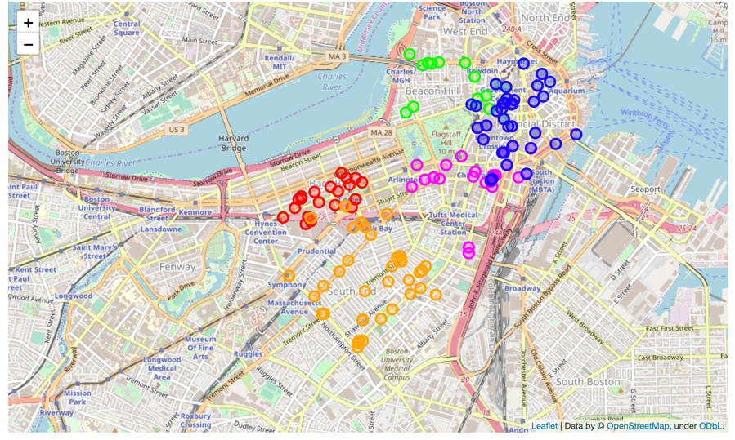
Folium Library and Leaflet Map
Figure 1: Circular marks represent the most frequently visited restaurants in the 5 hottest (Beacon Hill- Green, Back Bay- Red, South End- Orange, Chinatown- Magenta, Downtown- Blue) neighborhoods of Boston, according to Foursquare data.

Slide 5
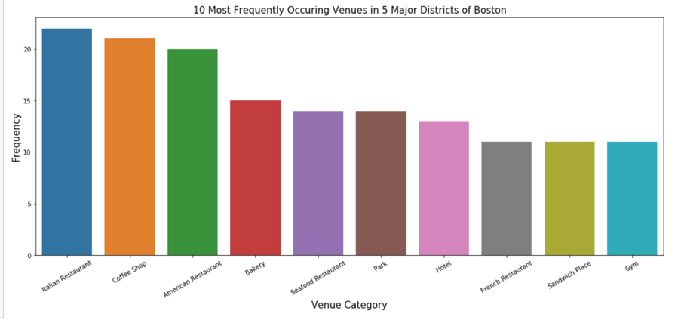
Exploratory Data Analysis
Figure 2: Most Frequent venues around these 5 neighborhoods according to Foursquare data.

Slide 6
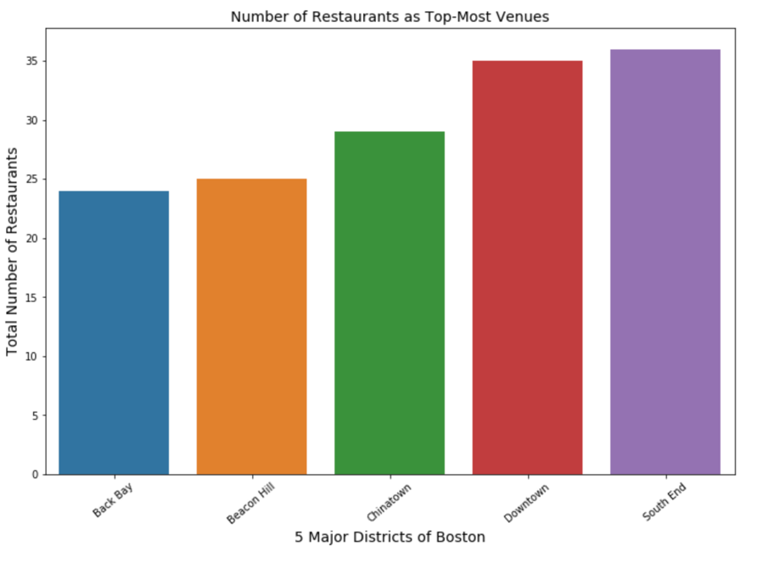
Exploratory Data Analysis
Figure 3: Number of restaurants as top most common venues in 5 neighborhoods of Boston.

Slide 7
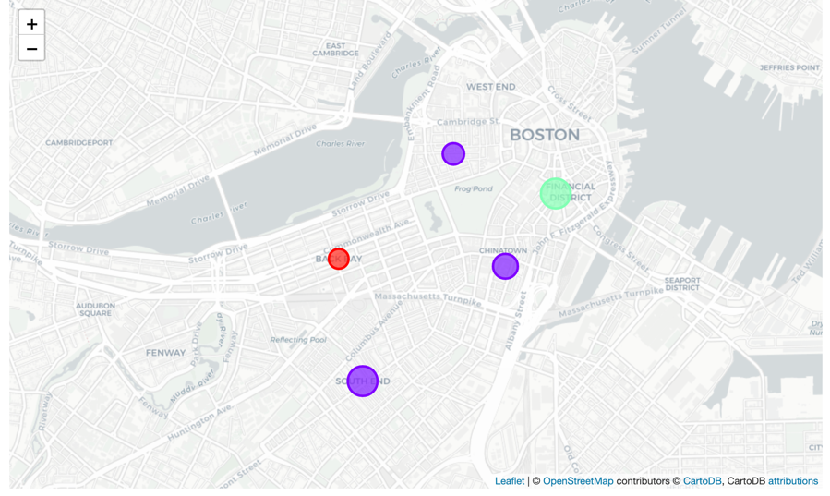
Clustering the Neighborhoods
Figure 4: 5 major neighborhoods of Boston segmented into 3 clusters based on the most common venues. The size of the circles represents number of restaurants as most common venues for each neighborhood

Slide 8
Results and Discussion
Italian restaurants top the charts of most common venues in the 5 districts.
Back Bay, Beacon Hill, Chinatown and South End districts are dominated by restaurants as the most common venue whereas Downtown area is dominated by historic sites and coffee shops as most common venues.
South End has maximum number of restaurants as the most common venue whereas Back Bay area has the least.
Since the clustering was based only on the most common venues of each district, Beacon Hill, Chinatown and South End are under the same cluster. Back Bay and Downtown are separate cluster as, Historic sites, coffee shop and hotels stand out as the common venue (with a very high frequency).

Slide 9
Conclusion
Downtown area will provide least competition for an upcoming restaurant as historic sites and coffee shops are the most common venue in this area and, the frequency of restaurants as common venue are very low compared to the remaining districts.
Also seen from the web-scrapped data, the average land price in and around Downtown is relatively cheaper compared to the districts close to central Boston.

Slide 10
Thanks

